Slide 1
Clustering of Energy usage in the US
Venkata Naga Siddartha Gutha
811220924

Slide 2
Data Description and Problem Statement
Data contains information about Energy in the United States.
Data table contains 608,565 rows and 20 variables which provides information
Data provides information on various aspects related to fuel like its cost, sulphur and ash contents, the heat produced per unit resource, suppliers, and many more.
Problem statement: Analysis of Energy resources is key for better energy management in the country. The aim is to identify similarities in energy usage and try to cluster in order to find insights from the data

Slide 3
Clustering technique used- K Means
K means is comparatively easy to implement
Suits best for large data sets
K Means take less time to cluster compared to hierarchical clustering
It is efficient in terms of computational cost

Slide 4
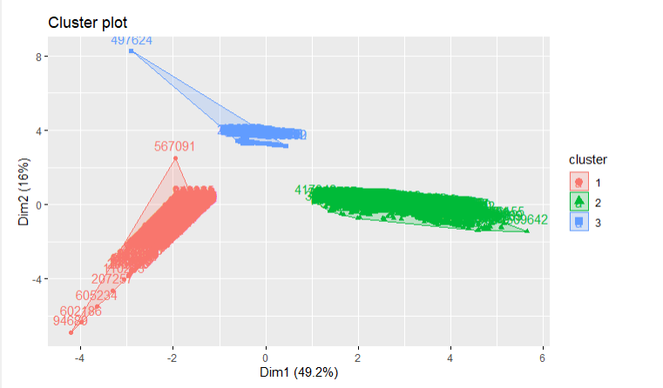
Clustering of Sample data

Slide 5
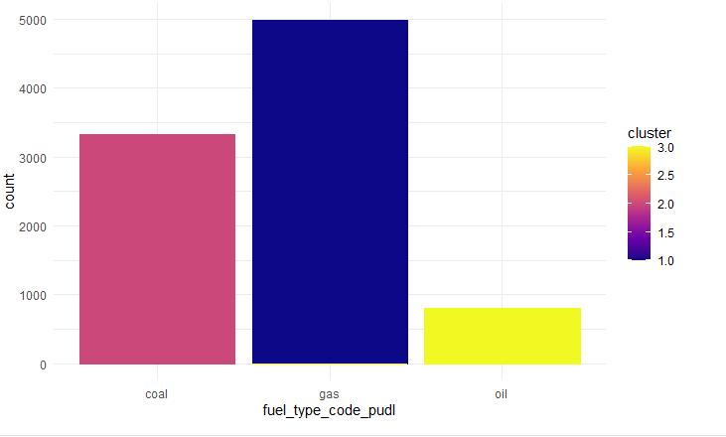
Type of fuel in each Cluster
The majority of fuel types in Cluster 1 , Cluster 2, and Cluster 3 are Gas, Coal and Oil respectively

Slide 6
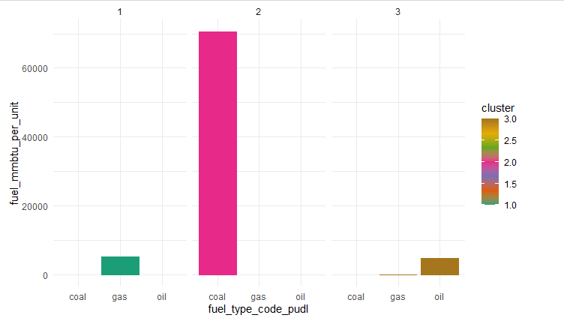
Heat content of fuel in each Cluster
It can be clearly seen that cluster 2 has maximum amount of Heat content

Slide 7
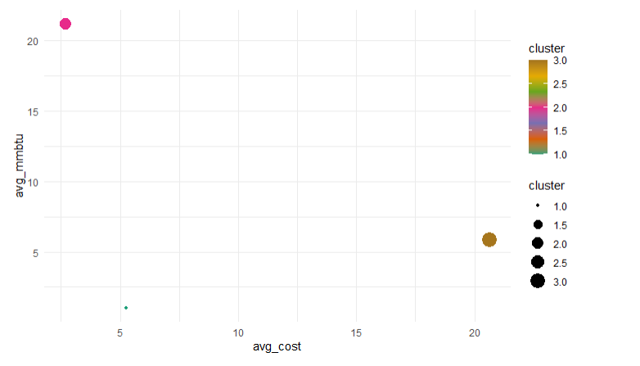
Average Cost of fuel Vs Average Heat
Cluster 2 has the least cost and can produce maximum heat.

Slide 8
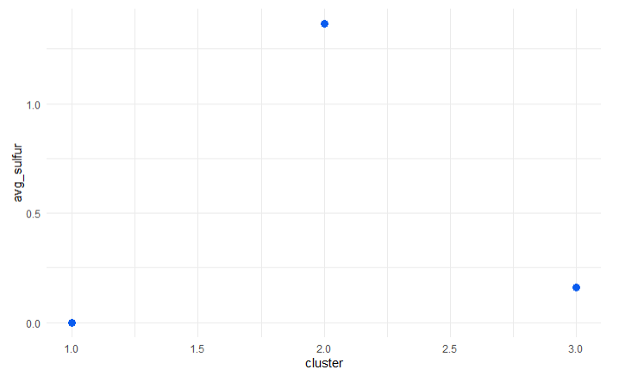
Average Sulphur content in each Cluster
Average Sulphur content is highest in cluster 2 and least in cluster 1

Slide 9
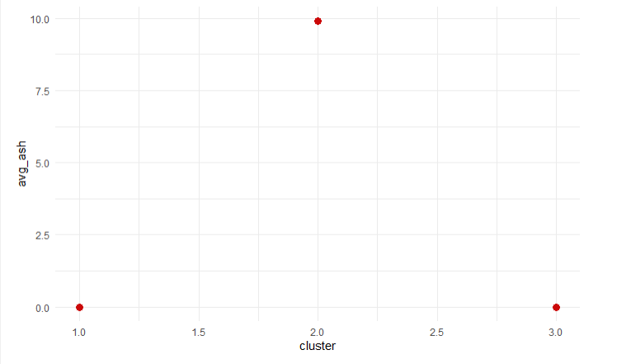
Average Ash content in each cluster
Average Ash content is highest in Cluster 2 and it is zero in the other two clusters

Slide 10
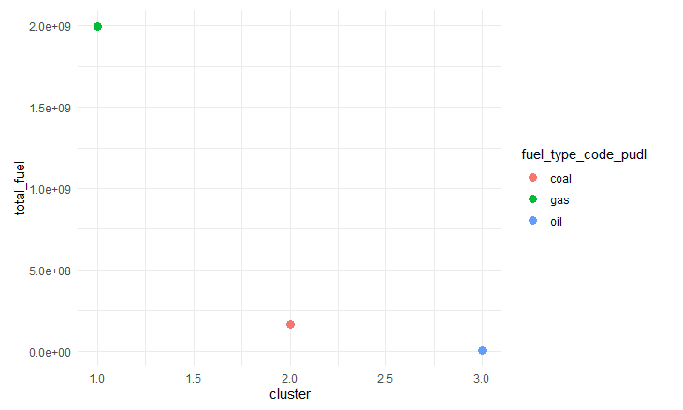
Total fuel received by each cluster
Cluster 1 (Gas) has received high fuel resources

Slide 11
Insights
Cluster 2 which has Coal as fuel has produced the majority of heat and that too at the least cost.
But cluster 2 is also the one with very high pollution.
So, it is the most efficient one to use but at the cost of pollution
On the other hand Cluster 1 has the least content of pollutants
Cluster 2 average heat produced is less compared to cluster 1 but on the positive side it is the cluster that has received the highest number of fuel units
Average cost per unit of fuel in cluster 3 is significantly high.
It is not so good in heat production and also has contents of sulphur

Slide 12
Naming Clusters
Cluster-1: Sustainable cluster
Cluster-2: Efficient cluster
Cluster-3: hopeless cluster

Slide 13
Conclusion
If the goal is to produce more heat at low cost, we need to choose the efficient cluster.
If the goal is to produce heat without causing any harm to nature then we need to choose the sustainable cluster

